Slide 1
Python Password
Wizard
By: Alex, Andrew, and Will

Slide 2
Python Password Wizard: Crafting Dynamic and Secure Passwords
-We chose this topic initially for a couple of reasons. So much of what we have done in this course is either the result of or directly interacting with weak passwords. Andrew witnessed at SecureWorld conference in Houston that it is a main topic of conversation of the industry. (Fun Fact, Verizon’s 2023 Data Breach Investigations Report states that 86% of breaches happen because of lost or stolen credentials.)
-This project is meant to be an option in a company’s security policy and procedures. This allows employees to be more efficient when creating a strong password . As weak or lazily written password are much easier to brute force. (Fun Fact, it is commonly held that it will take 34,000 years to crack a 12 digit password with uppercase letters, lowercase letters, numbers, and special characters.)
-Research Ideas Were sparked by using https://cybercademy.org/project-ideas/ We found a video that gave us an example of the type of syntax we would need to do when writing. Then we needed to do research on the differences between versions of python so that we could understand why our code and the source needed to be so different. Then we further did research into how often weak passwords are involved in data breaches. We also needed to do a fair bit of research into python script-writing, as we hit a few roadblocks in our project.

Slide 3
Demonstration Preview
Installed passwordmeter - using Sudo apt install passwordmeter.
Running python --version to see which python we were running which gave 3.8.4. and 3.11.6 on other VMs.
Then we ran python3 in our terminal (interface).
We ran import passwordmeter inside the Python3 interface.
After Exiting the Python interface we moved into our Python folder.
We had to Sudo apt install gedit (a text editor which we found online).
Created a file that is executable with Python3 ( passgen.py).
Ran sudo gedit on passgen.py entered the script, saved and exited.
Ran the script python3 passgen.py.
We got our passwords along with the strength level as an output.

Slide 4
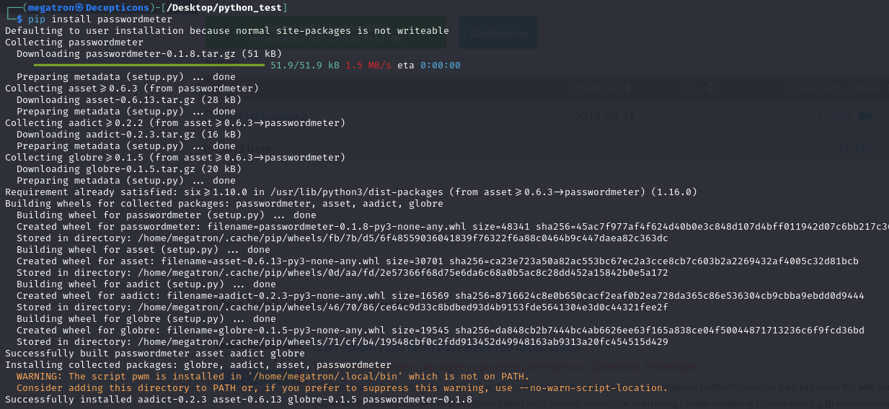
Installation of Password Meter

Slide 5
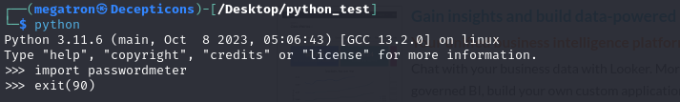
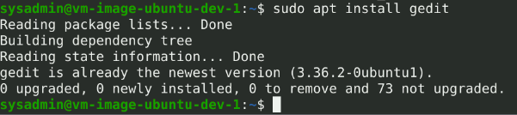
Python Version

Slide 6
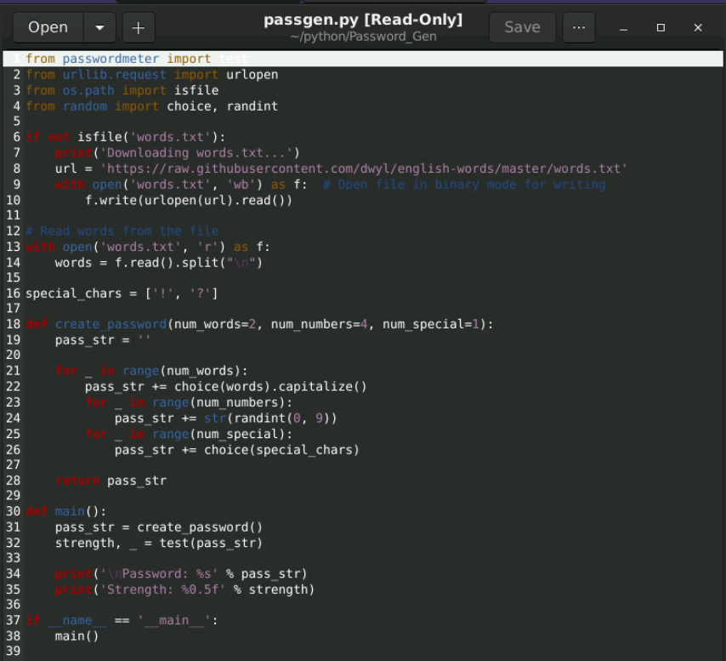
Passgen Script

Slide 7
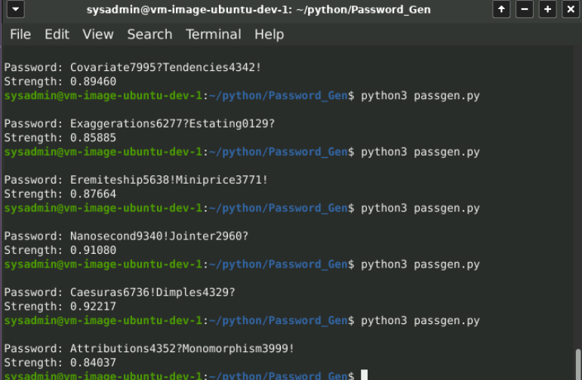
Password Output with Strength Score
Our Baseline of 2 ,4 ,1 gives us a Consistent effective Flow of Strong Passwords.

Slide 8
Presentation Summary
In summary this Script is targeted for people in a Non-Technical background for simplicity and efficiency while not sacrificing the integrity of password security.
This will also help companies implement a standard to enhance password strength across multiple departments. Numerous class activities/assignments and CTF required us to exploit vulnerabilities with weak passwords which granted unauthorised login and privilege escalation depending on the user profile that was compromised.
Also as per the demonstration, we changed the variables for creating the password and concluded that once the password contained all 3 characteristics and standard of 2 words,4 numbers and 1 special character; anything more than that did not significantly increase the strength.

Slide 9
Credits
Project Idea: https://cybercademy.org/beginner-projects/ Password Meter: https://github.com/cadithealth/passwordmeter Youtube Guides:https://www.youtube.com/watch?v=-C5g4J7iCj8 Research Materials: https://www.verizon.com/business/en-nl/resources/reports/dbir/
https://www.datacamp.com/blog/python-2-vs-3-everything-you-need-to-know
https://www.sciencedirect.com/science/article/abs/pii/S2214212618305027

